Slide 1
Consortia reporting in Alma Analytics for overlap analysis
Yoel Kortick – Senior Librarian

Slide 2

Contents
  Introduction
  Duplicate electronic collections in different member institutions linked to CZ
  Duplicate titles by 035a for NETWORK institution
  Duplicate titles by ISBN for NETWORK institution
  Duplicate titles by ISSN for NETWORK institution
  Duplicate titles by Title Author Combined and Normalized for NETWORK institution
  Titles with inventory in only one institution based on field 035 subfield a with library and location

Slide 3
Introduction

Slide 4
Introduction
Alma Analytics contains a wide variety of reports designed specifically for consortia.
These reports are in the default folder “/shared/Alma/Consortia/Reports”.
This presentation will focus on the reports which check for overlap among the same titles in different institutions of the consortia, including the network zone institution.

Slide 5
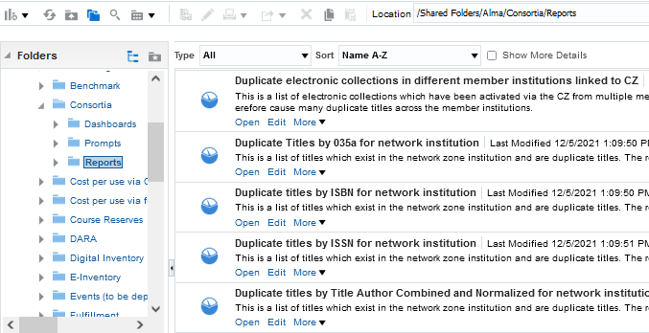
Introduction

Slide 6
Duplicate electronic collections in different member institutions linked to CZ

Slide 7
Duplicate electronic collections in different member institutions linked to CZ
This is a list of electronic collections which have been activated via the CZ from multiple member institutions.
The electronic collections have not been activated from the network zone using the “available for” functionality and therefore cause many duplicate titles across the member institutions.

Slide 8
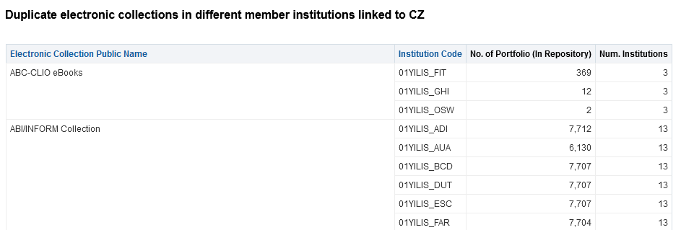
Duplicate electronic collections in different member institutions linked to CZ
This electronic collection and all corresponding portfolios have been activated in 13 different institutions instead of once in the CZ.

Slide 9
Duplicate titles by 035a for NETWORK institution

Slide 10
Duplicate titles by 035a for NETWORK institution
This is a list of titles which exist in the network zone institution and are duplicate titles.
The records are determined to be duplicates based on the 035 field subfield a.

Slide 11
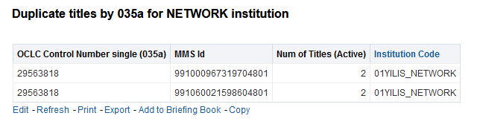
Duplicate titles by 035a for NETWORK institution
On the next slide we will look at this example

Slide 12
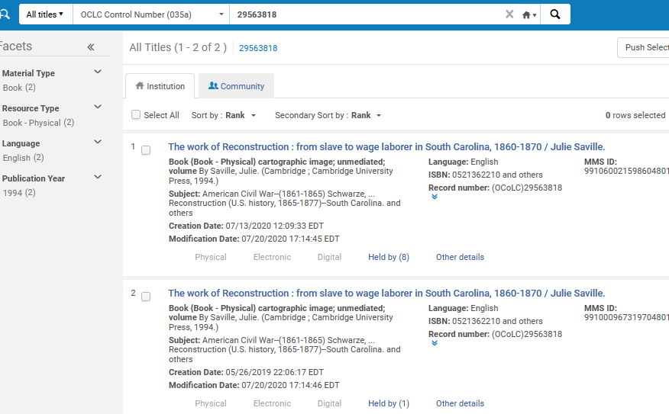
Duplicate titles by 035a for NETWORK institution

Slide 13
Duplicate titles by ISBN for NETWORK institution

Slide 14
Duplicate titles by ISBN for NETWORK institution
This report retrieves duplicate titles by field ISBN in a network zone institution and excludes titles linked to the CZ.
This report is designed to be run in the network zone.

Slide 15
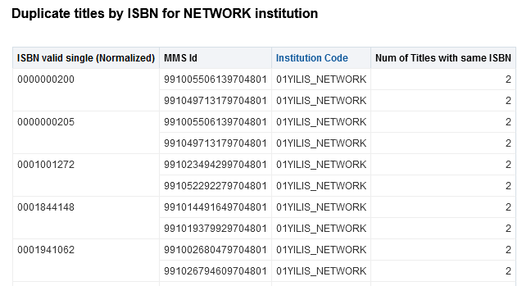
Duplicate titles by ISBN for NETWORK institution
On the next slide we will look at this example

Slide 16
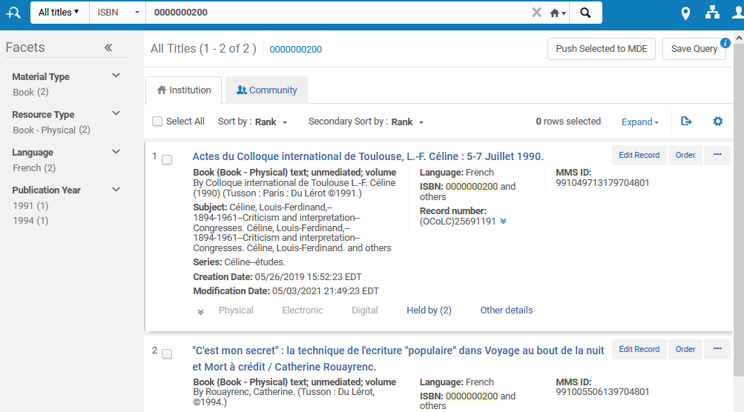
Duplicate titles by ISBN for NETWORK institution

Slide 17
Duplicate titles by ISSN for NETWORK institution

Slide 18
Duplicate titles by ISSN for NETWORK institution
This report retrieves duplicate titles by field ISSN in a network zone institution and excludes titles linked to the CZ.
This report is designed to be run in the network zone.

Slide 19
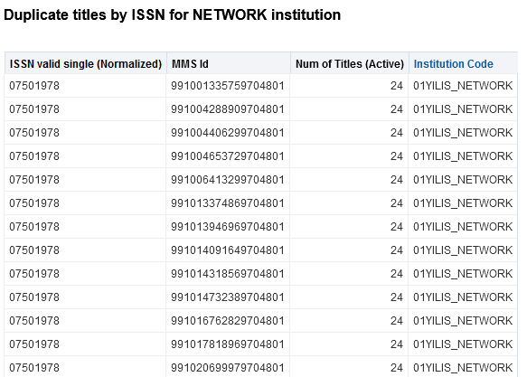
Duplicate titles by ISSN for NETWORK institution
On the next slide we will look at this example

Slide 20
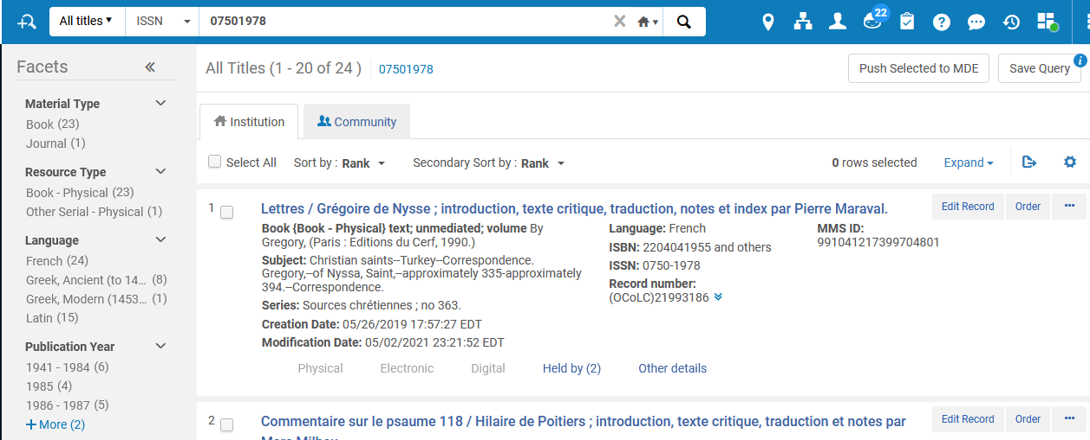
Duplicate titles by ISSN for NETWORK institution

Slide 21
Duplicate titles by Title Author Combined and Normalized for NETWORK institution

Slide 22
Duplicate titles by Title Author Combined and Normalized for NETWORK institution
This report retrieves duplicate titles by field Title Author Combined and Normalized in a network zone institution and excludes titles linked to the CZ.
This report is designed to be run in the network zone.

Slide 23
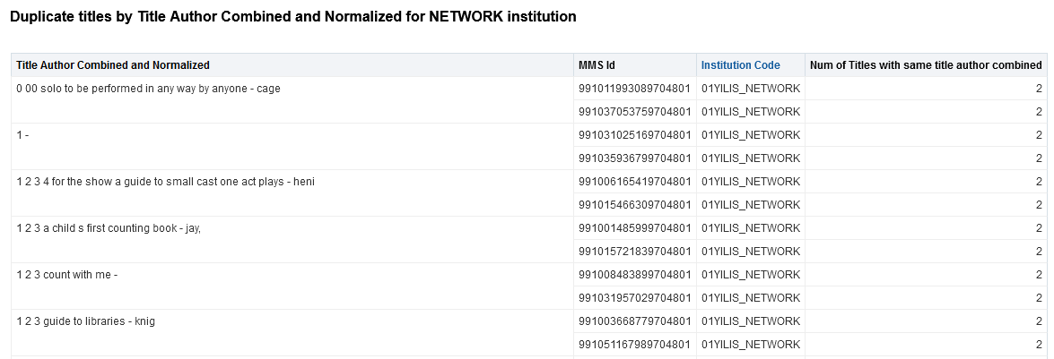
Duplicate titles by Title Author Combined and Normalized for NETWORK institution
On the next slide we will look at this example

Slide 24
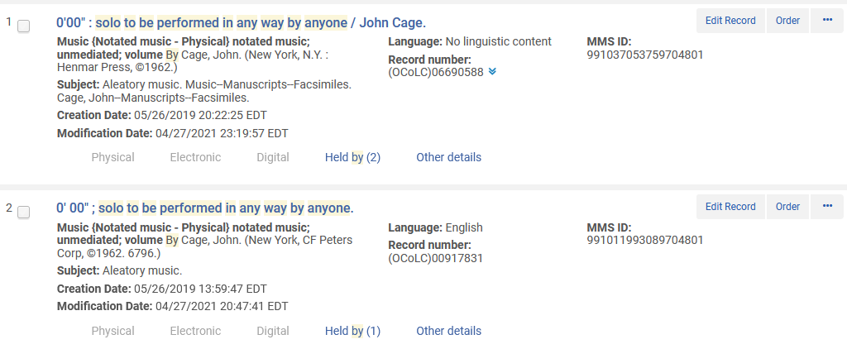
Duplicate titles by Title Author Combined and Normalized for NETWORK institution

Slide 25
Titles with inventory in only one institution based on field 035 subfield a with library and location

Slide 26
Titles with inventory in only one institution based on field 035 subfield a with library and location
This report retrieves titles held by only one institution in the consortia.
The analysis uses the field 035 subfield a as a basis for determining the uniqueness of the title.
This report is designed to be run in the network zone.

Slide 27
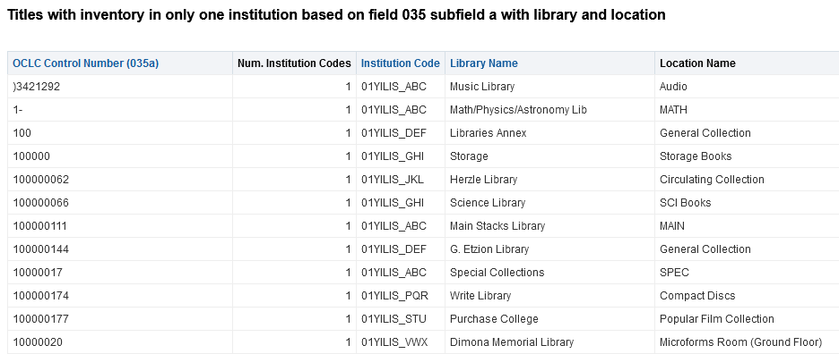
Titles with inventory in only one institution based on field 035 subfield a with library and location
On the next slide we will look at this example

Slide 28
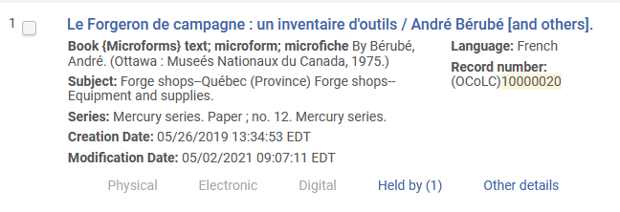
Titles with inventory in only one institution based on field 035 subfield a with library and location

